Slide 1
LAY OF THE LAND
FLORIDA LAND CONFERENCE
OPPORTUNITY ZONES:
Will Florida Business Capitalize on the Opportunity?
Orlando Omni Resort at ChampionsGate
March 28, 2019
Michael D. Minton, Esq. • Stephen R. Looney, Esq.

Slide 2


Slide 3
Opportunity Zones
Overview
  Tax Cuts & Jobs Act
  Designated Opportunity Zones
  Florida’s Designated Opportunity Zones
  Cumulative Benefits to Investing
October 19th Proposed Regulations
  Forms
  Issues Addressed
  May be relied on by taxpayers
October 19th Revenue Ruling 2018-29
What’s next?
  Issues still Outstanding
  Second round of regulations?

Slide 4
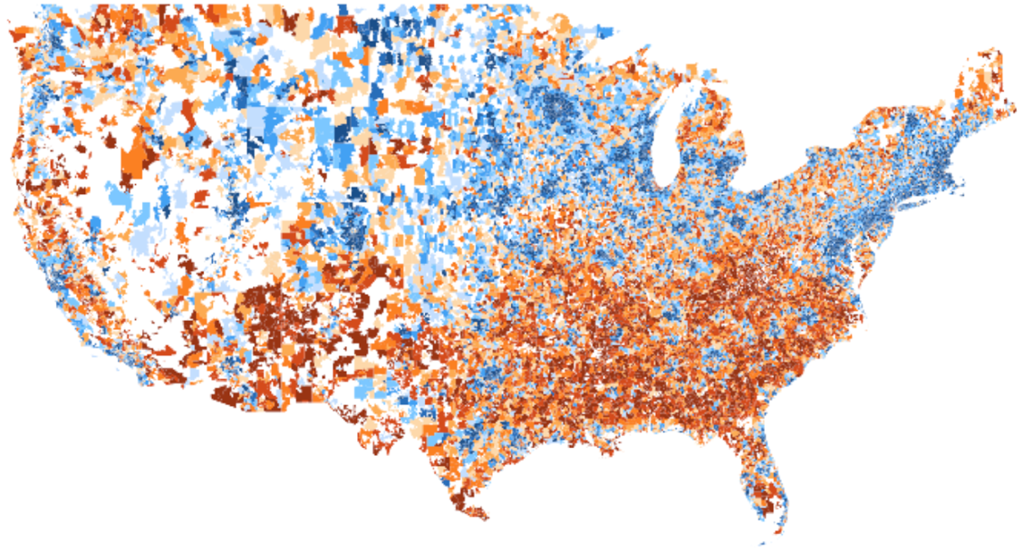

52 million Americans (1 in 6) live in economically distressed communities.
Nearly 1.9M Floridians live in economically distressed zip codes.
Prosperous
Distressed
Source: EIG’s “Distressed Communities Index”

Slide 5
Opportunity Zones
On or before March 21, 2018, or April 22 with extension, the chief executive officer of each state was allowed to designate low-income census tracts as Opportunity Zones
The chief officer was allowed to designate up to 25% of the number of low-income communities in the State
  If a state had less than 100 low-income tracts, the chief officer could designate up to 25 opportunity zones
After timely designation, the Secretary of the Treasury had 30 days to approve each zone
Designations have all been made by States and approved by the Secretary of the Treasury

Slide 6
Opportunity Zones
Notice 2018-48 lists all of the population census tracks designated as Qualified Opportunity Zones:
https://www.irs.gov/pub/irs-drop/n-18-48.pdf
Map of all QOZs: https://www.cims.cdfifund.gov/preparation/?config=config_nmtc.xml

Slide 7
Florida Opportunity Zones
427 census tracts
Every Florida County
Designated by Governor Scott
on April 18, 2018
Opportunity Zones certified by Treasury
on June 14, 2018
A list of zones and interactive map may
be found on the Florida Department of
Economic Opportunity website - http://www.floridajobs.org/business-growth-and-partnerships/for-businesses-and-entrepreneurs/business-resource/opportunity-zones

Slide 8
2017 Tax Cuts & Jobs Act
Created §1400Z-1 & §1400Z-2 Internal Revenue Code
New rules for capital gains invested in opportunity zones. Three main tax benefits:
  Deferral of any amount treated as capital gain (short-term or long-term);
  Reduction of amount of gain realized through a basis adjustment; and
  Exclusion of gain on disposition of interest in a qualified opportunity fund.

Slide 9
180 Day Rule – Proposed Regulation 10.19.18
Section 1400Z-2 permits a taxpayer to defer recognition of a capital gain (see Form 8949) if an amount equal to such gain is invested in a qualified opportunity fund (“QOF”) within 180 days of the date that the tax would have been recognized by the taxpayer.
The Proposed Regulations allow for a very liberal application of this 180 day rule for partnerships, S corporations and other pass-through entities, such as trusts and estates, to defer capital gains at the entity level, or if the partnership or S corporation (or other pass-through entity) decides not to defer gain and invest in a QOF, the partners or shareholders (or beneficiaries) can make the elections on their portion of their distributive share of such income. In the case where the partner, shareholder or beneficiary elects to defer the gain, the 180-day deferral period begins on the last day of the taxable year of the partnership, S corporation or other pass-through entity in which such partner’s, shareholder’s or beneficiary’s allocable share of such gain was taken into account.

Slide 10
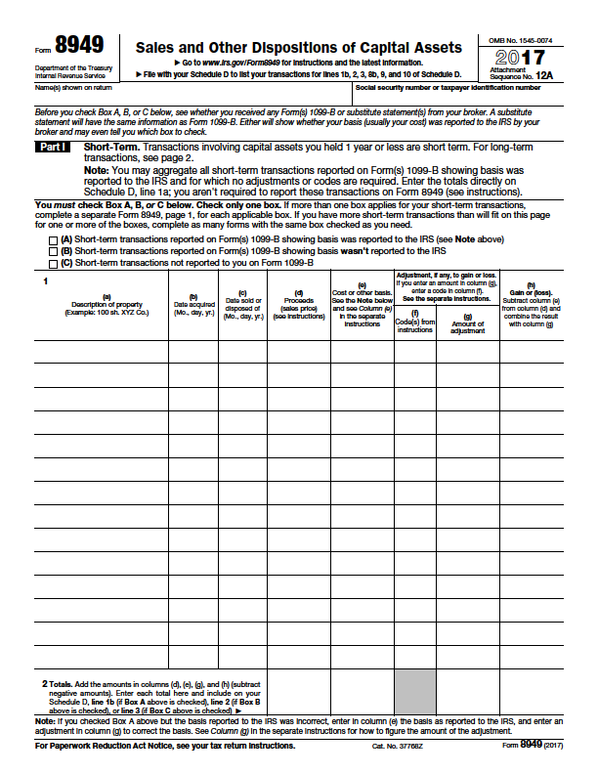
Form 8949

Slide 11
Investment Length | Benefits are Progressive
Less than 5 years | Deferred recognition of capital gain reinvested into a QOF until earlier of December 31, 2026 or date the interest in QOF is sold or exchanged
5-7 years | Deferred recognition above plus 10% increase in basis on initial gain invested
7-10 years | Deferred recognition of reinvested capital gain until earlier of December 31, 2026 or date interest in QOF is sold or exchanged plus another 5% increase in basis
Greater than 10 years | Deferred recognition of reinvested capital gain until earlier of December 31, 2026 or date interest in QOF is sold or exchanged plus 15% basis step up on initial gain invested AND investors get a step up in basis equal to fair market value in their interest in the QOF if held for > 10 years.

Slide 12
Sample Investment
Jan. 2, 2018
Taxpayer enters into a sale that generates $1M of capital gain
June 30, 2018
(Within 180 days), Taxpayer contributes entire $1M of capital gain to a QOF
Taxpayer is deemed to have a $0 basis in its QOF investment
QOF Invests the $1MM in Qualified Opportunity Zone Property
2018
2019
2020
2021
2022
2023
2024
2026
2027
2028
2029

Slide 13
Sample Investment
Dec. 31, 2026
$850K of the 1MM of deferred capital gains are taxed and the basis in QOF investment increases to $1MM.
June 30, 2028
(10 years later), Taxpayer sells investment for $2.0MM. Basis is deemed to be FMV.
Thus, no tax on appreciation
Jan. 1, 2018
Taxpayer enters into a sale that generates $1M of capital gain
June 30, 2023
(After 5 years), Taxpayer’s basis in QOF investment increases from $0 to $100k
June 30, 2025
(After 7 years), Taxpayer’s basis in QOF investment increases from $100k to $150k
June 30, 2018
(Within 180 days), Taxpayer contributes entire $1M of capital gain to a Qualified Opportunity Fund
Taxpayer is deemed to have a $0 basis in its QOF investment
QOF Invests the $1MM in Qualified Opportunity Zone Property
2018
2019
2020
2021
2022
2023
2024
2025
2026
2027
2028

Slide 14
Qualified Opportunity Fund (QOF)
Definition
A QOF is an investment vehicle set up as a corporation or partnership (includes limited liability companies)
Eligible investors include individuals, C corporations, REITs, partnerships, S corporations, trusts and estates
The QOF uses invested capital to make equity investments in qualified property located in Opportunity Zones

Slide 15
Qualified Opportunity Fund (QOF)
Definition – Asset Test
QOFs must hold at least 90% of their assets in Qualified Opportunity Zone Property which includes:
  (1) Qualified Opportunity Zone partnership interests,
  (2) Qualified Opportunity Zone stock, or
  (3) Qualified Opportunity Zone business property, measured on the last day of the first six-month period of the taxable year of the fund, and on the last day of the taxable year of the fund.

Slide 16
Qualified Opportunity Fund (QOF)
Self-Certification
Form 8996
  Must identify the first year the eligible entity wants to be a QOF.
  May identify the first month the eligible entity wants to be a QOF.
Form 8996 is filed annually with the QOF’s tax return.

Slide 17
Form 8996

Slide 18
Proposed Regulation 10.19.18
Qualified Opportunity Zone Property
Qualified Opportunity Zone Property means:
  (1) Qualified Opportunity Zone Stock;
  (2) Qualified Opportunity Zone Partnership Interest; or
  (3) Qualified Opportunity Zone Business Property.
  The Proposed Regulations elaborate on the definitions of each of these terms.

Slide 19
Proposed Regulation 10.19.18
Note the Cascading Effect!
As stated above, a QOF must hold at least 90% of its assets in Qualified Opportunity Zone Property, either directly or through a Qualified Opportunity Zone Stock or Qualified Opportunity Zone Partnership Interest. The Proposed Regulations provide taxpayer-friendly provisions which allow the value of the QOF’s entire interest in an entity to count for the QOF’s satisfaction of the 90% asset test, and which provide that stock or a partnership interest will be treated as Qualified Opportunity Zone Stock and Qualified Opportunity Zone Partnership Interest if at least 70% of such entity’s assets are in Qualified Opportunity Zone Business Property.
Consequently, it appears that indirect ownership (as opposed to direct ownership) makes it easier to be treated as a QOF.

Slide 20
Investments in Qualified Opportunity Zone Property
Qualified Opportunity Zone Fund
$
$
Qualified Opportunity Zone Partnership Interest
Qualified Opportunity Zone Stock
$
Qualified Opportunity Zone Business Property

Slide 21
Qualified Opportunity Zone Business
Applies to Qualified Opportunity Zone Stock and Qualified Opportunity Zone Partnership Interests
Qualified opportunity zone business is a trade or business in which substantially all (70%) of the tangible property owned or leased by the taxpayer is Qualified Opportunity Zone Business Property and:
  ≥50% of income is from active conduct of a trade or business;
  Substantial portion of intangible property is used in an active conduct of business; and
  Less than 5% of the unadjusted basis of property is in “nonqualified financial property.”
Cannot be an excluded business like a golf course or a “sin business.”

Slide 22
Qualified Opportunity Zone Business
Proposed Regulations create a 31-month “working capital” safe harbor for Qualified Opportunity Zone Businesses that acquire, construct, or rehabilitate real and tangible business property in an OZ
  Allows QOZBs to hold cash or other liquid assets as long as there is a written schedule or plan consistent with the ordinary business operations that such working capital will be used within the 31-month period to acquire, construct or substantially improve the OZ property
  But what about contingencies for hurricanes and other natural disasters?

Slide 23
Qualified Opportunity Zone Business Property
Tangible property used in a trade or business
Acquired by purchase from an unrelated party (20% threshold) after December 31, 2017
During substantially all of the holding period, substantially all the use is in QOZ
Original use in QOZ commences with the taxpayer
  OR
Taxpayer substantially improves the property during 30-months after acquisition
    Double Basis in Improvement

Slide 24
Proposed Regulations – 10.19.18
Clarifies the “substantially all” threshold is satisfied if at least 70 percent of the tangible property owned or leased by the business is Qualified Opportunity Zone Business Property
Provides QOF includes any entity that is treated as a corporation or partnership for federal income tax purposes, and thus limited liability companies may qualify as a QOF
Clarifies taxpayers may make the basis step-up election after a qualified opportunity zone designation expires, until December 31, 2047
Addresses illusory concerns raised by early commentators regarding December 31, 2028 Sunset liberally for taxpayer

Slide 25
Revenue Ruling 2018-29 – 10.19.18
Addresses investments in buildings and land
Clarifies Qualified Opportunity Zone Business Property is tangible property used in a trade or businesses
Clarifies the “original use” requirement.
Consistent with the intent of the legislation, a building located on land within an OZ is substantially improved if, during any 30-month period beginning after the date of acquisition of the building, additions to the basis in the building exceed an amount equal to the taxpayer’s adjusted basis of the building at the beginning of the period
The cost of the land is not included in the taxpayer’s adjusted basis

Slide 26
What’s Next
Many Unanswered Questions
Selected Open Issues
  Initial 180 day rule – Safe Harbor Post Regulations
  Clarification of “original use”
  Further clarification of “substantial improvement,” and “substantially all”
  Form and instructions for deferral elections
  90% asset test penalties
  Address reasonable time for reinvestment
Additional Proposed Regulations were expected January 2019
Delayed Due to Government Shutdown

Slide 27
Florida Bar Tax Section Comments:
  1) Original use of Building Commences with C.O.
  2) Will non-brick & mortar improvements qualify for original use and substantial improvement
  3) Leased Property – Distinguish between Operational Lease and Long Term/Ground Leases
  4) Tacking of Holding Period
  5) How can Non-U.S. Persons Participate?

Slide 28


Questions?
Stephen R. Looney, Esq.
Slooney@deanmead.com (407) 428-5238
Michael D. Minton, Esq.
mminton@deanmead.com (772) 464-7700
Dean, Mead, Egerton, Bloodworth, Capouano & Bozarth, P.A.
420 S. Orange Avenue, Suite 700
Orlando, Florida 32801

