Slide 1
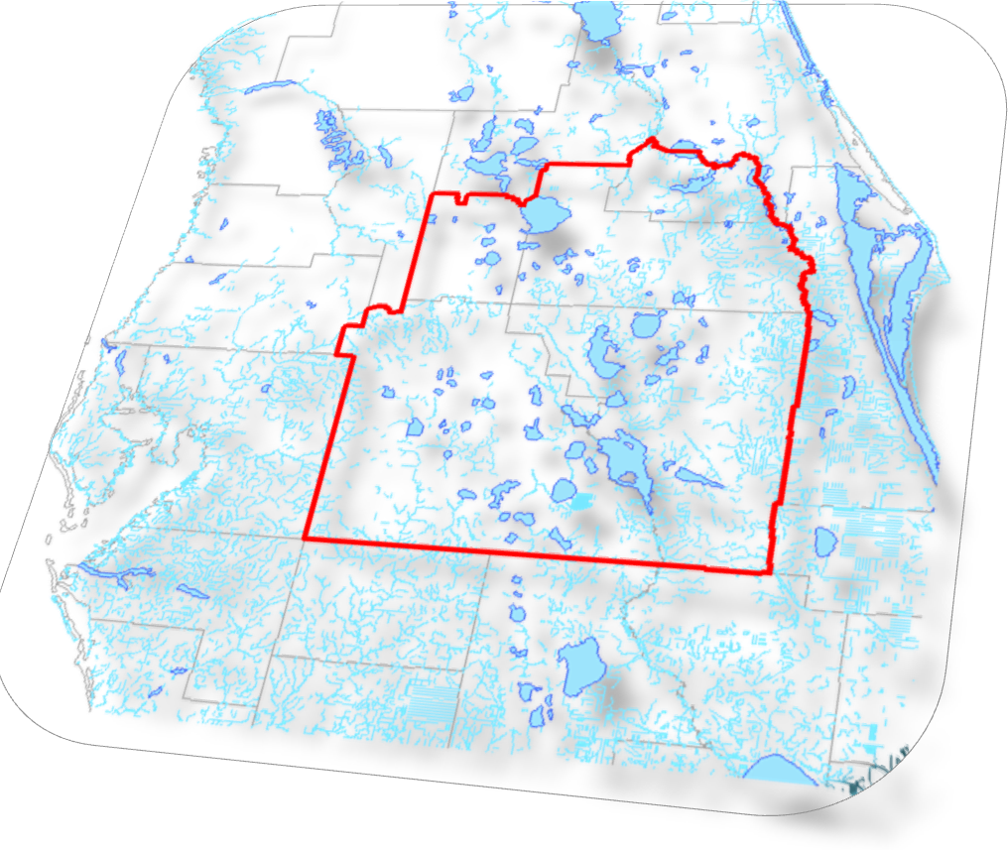
Central Florida Water Initiative
Water For Tomorrow

Slide 2
Welcome and Overview
Michael Minton
Dean Mead
Notes:
Guidance Document outlines the process based on three Guiding Principles
The work of the technical teams will result in:
one shared groundwater model
one coordinated strategy for minimum flows and levels prevention and recovery
one regional water supply plan
Involving the public is an essential part of the regional water supply planning process.

Slide 3
Central Florida
Water Initiative:
Why this Matters
Jim Fletcher
Extension Director
UF IFAS Osceola Extension
Michael Minton
Shareholder
Dean Mead
Notes:
Guidance Document outlines the process based on three Guiding Principles
The work of the technical teams will result in:
one shared groundwater model
one coordinated strategy for minimum flows and levels prevention and recovery
one regional water supply plan
Involving the public is an essential part of the regional water supply planning process.

Slide 4
Background and Review of the
Proposed Solution Plan
Robert Beltran
Executive Director
Southwest Florida WMD
Notes:
Guidance Document outlines the process based on three Guiding Principles
The work of the technical teams will result in:
one shared groundwater model
one coordinated strategy for minimum flows and levels prevention and recovery
one regional water supply plan
Involving the public is an essential part of the regional water supply planning process.

Slide 5
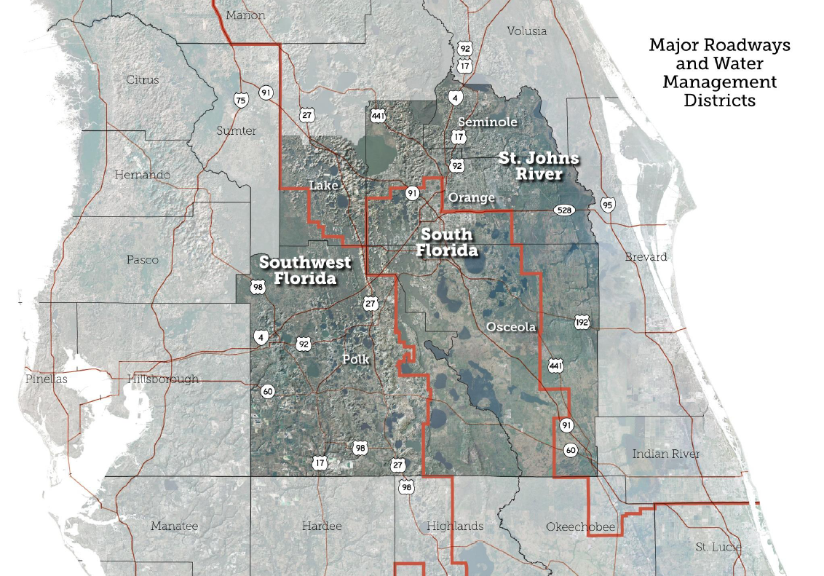
(Southern)
Notes:
CFWI region
Collaborative effort between Districts, FDEP, FDACS, utilities, and other stakeholders
Technical teams provided strong scientific foundation for development of Planning docs
Led by Steering Committee

Slide 6
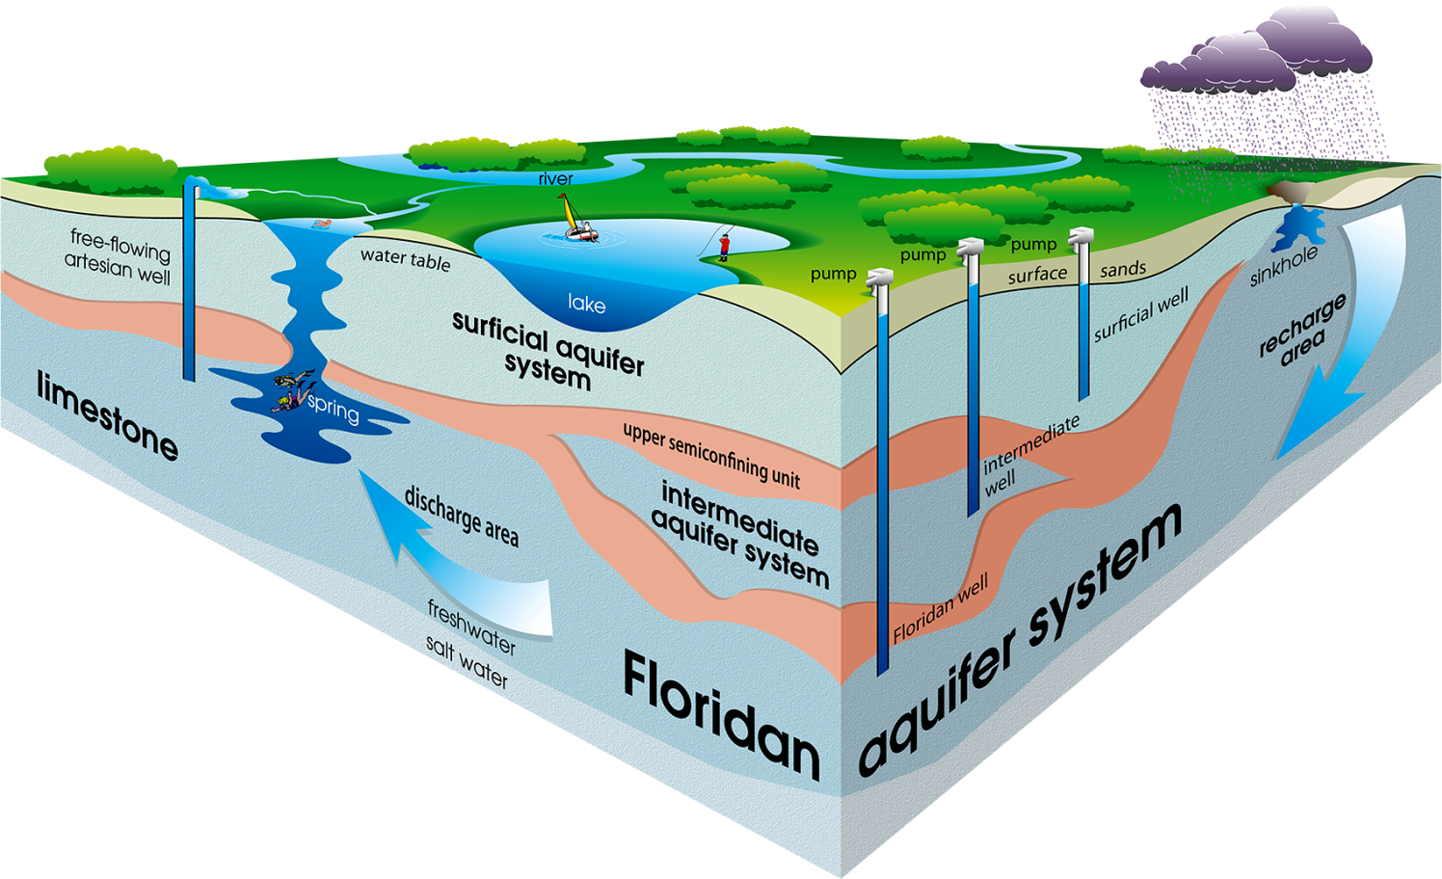
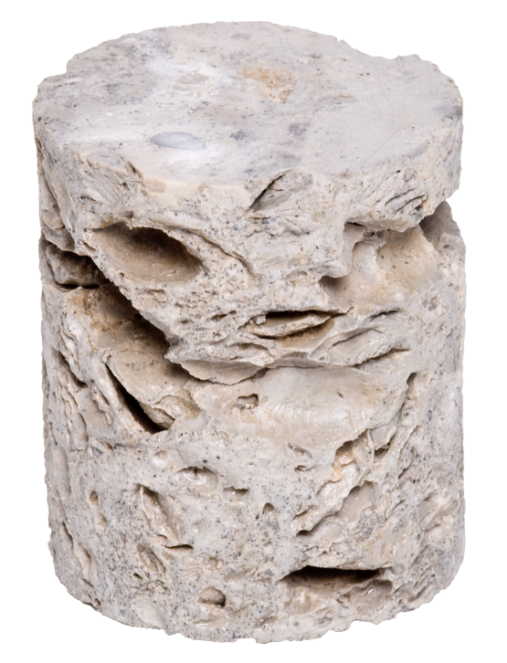
Where Does Our Water Come From?
More than 90% of our water comes from the aquifer system.

Slide 7
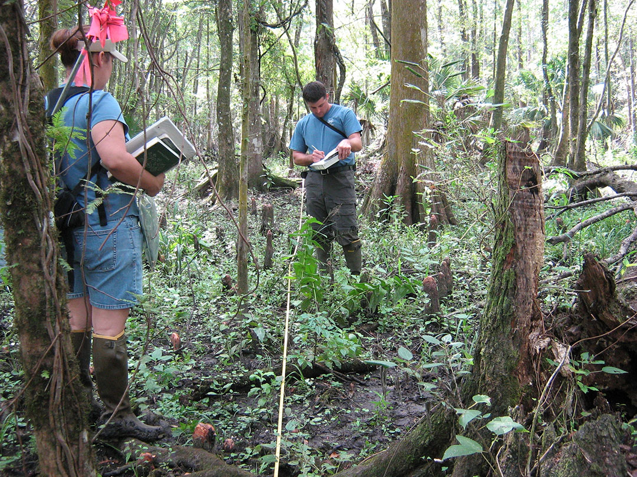
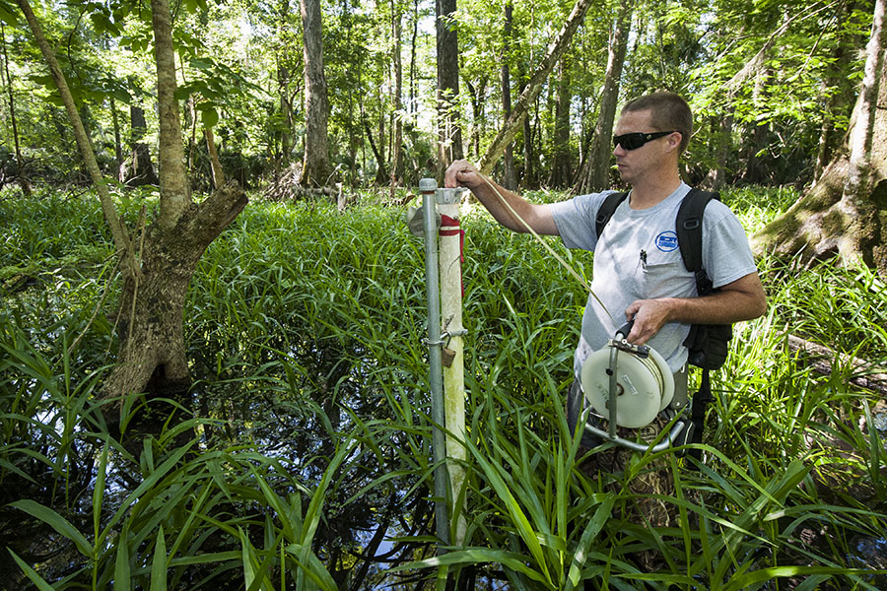
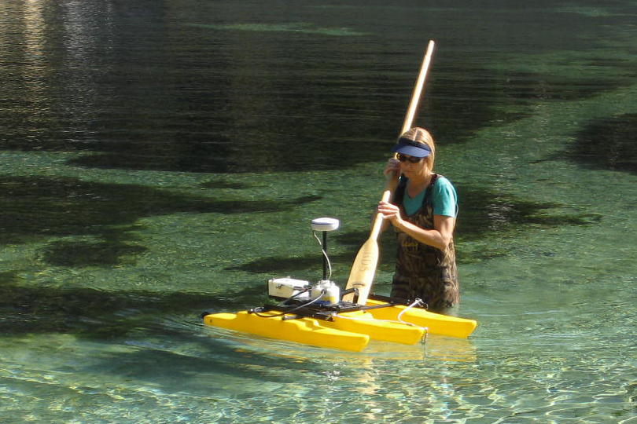
What Happens When We Overuse the Aquifer?
Wetlands
Spring flow
Lake and river levels

Slide 8

What Happens When We Overuse the Aquifer?
FRESHWATER
Aquifer
Acts like a sponge, drawing water down from the land surface.
Draws salt water up into freshwater zones.
SALT WATER

Slide 9
What is CFWI?
A collaborative regional water supply effort to protect, conserve and restore our water resources.

Slide 10
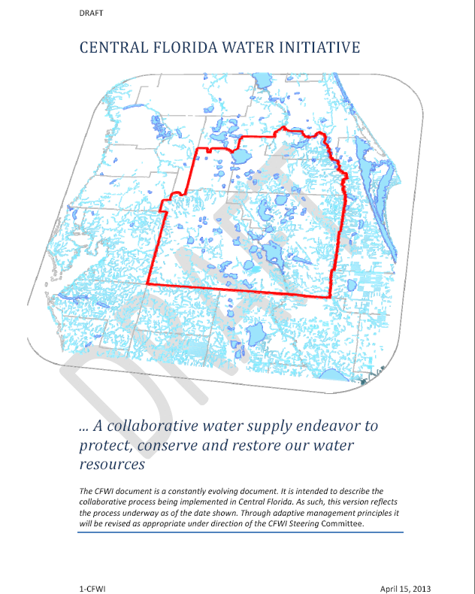
Guidance Document
Principles
  Identify sustainable quantities of groundwater sources
  Develop strategies to meet water demands
  Establish consistent rules
Notes:
Guidance Document outlines the process based on three Guiding Principles
The work of the technical teams will result in:
one shared groundwater model
one coordinated strategy for minimum flows and levels prevention and recovery
one regional water supply plan
Involving the public is an essential part of the regional water supply planning process.

Slide 11
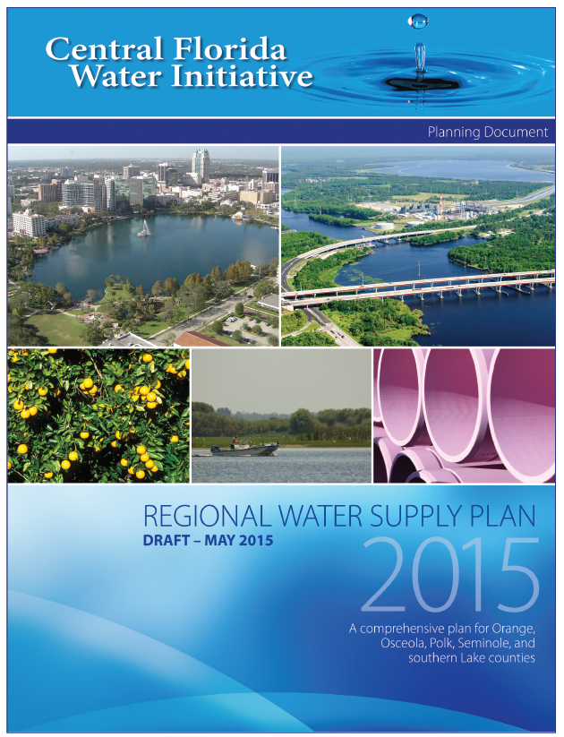
One RWSP for the CFWI Region
Collaborative effort
Scientific foundation
Stakeholder driven
Demands from all categories
Potential sources and projects
Water resource evaluation
Funding mechanisms
  Update every 5 years
    20-year planning horizon
Notes:
Developing first-ever CFWI Regional Water Supply Plan
Collaborative effort between Districts, FDEP, FDACS, utilities, and other stakeholders
Technical teams provided strong scientific foundation for development of Plan
CFWI RWSP is being developed to address both short-term and long-term water issues.
Water demand projections are based on best available data.
The RWSP will identify options to meet projected demands.
Demands from all categories
20-year planning horizon
How to meet the demands
Potential sources
Project options
Evaluation of water resources
Funding mechanisms
Update every 5 years

Slide 12
Solutions Discussion
Robert Beltran
Executive Director, Southwest Florida WMD
Len Lindahl, P.E.
Assistant Executive Director, South Florida WMD
Michael Register
Director, Division of Regulatory, Engineering and Environmental Services, St. Johns River WMD
Mark Hammond Director, Resource Management, Southwest Florida WMD Len Lindahl, P.E. Assistant Executive Director, South Florida WMD Michael Register Acting Executive Director, St. Johns River WMD
Notes:
Guidance Document outlines the process based on three Guiding Principles
The work of the technical teams will result in:
one shared groundwater model
one coordinated strategy for minimum flows and levels prevention and recovery
one regional water supply plan
Involving the public is an essential part of the regional water supply planning process.

Slide 13
Solutions Team
Subtasks:
  Review regional alternatives
  Develop water supply and conservation options
  Identify partnerships/encourage interconnects
  Identify need for recovery/prevention
  Monitoring/Assessment in conjunction with DMIT
  Workshops and public meetings
  Identify funding needs for regional projects
Notes:
The team will develop strategies to meet future water demands by optimizing the use of existing groundwater, identifying demand management activities, identifying viable alternative water supplies, and establishing consistent rules.
The team will be working closely with all key stakeholders to gain community and financial support for these critical projects.
Its work is projected to be completed by the end of 2014.

Slide 14
Key Findings
Solutions Phase
Water conservation is an important element
Sufficient options to meet the regions’ needs through 2035
  150 options – more than 334 mgd
Conceptual management strategies can be developed into specific projects
Stakeholder engagement has and will continue to be important
Project cost estimates scenario
  $2.8 billion for 225 mgd
Establishment of consistent rules and regulations to be developed to implement the results of CFWI Planning effort
Implementing results of CFWI is critical to long-term sustainability

Slide 15
Implementation Strategy
technical aspects of the CFWI Implementation Plan
Implement Water Conservation Programs
Develop Specific Prevention and Recovery Projects
Support Development and Implementation of Regional Project Solutions
Support Additional AWS Projects
Improve Water Resource Assessment Tools and Supporting Data
Develop Options for Consistent Rules and Regulations
Continued Communication and Outreach
Identify Options for Future CFWI Framework to Support Implementation Strategies

Slide 16
Water Conservation
technical aspects of the CFWI Implementation Plan
5-year Plan
  Public Supply & Other Self Supply
    10 BMPs
  Adopt High-Efficiency Standards
    Landscape and Irrigation Systems
    Plumbing Fixtures and Appliances
  Public Education
  Clearinghouse/Conservation Planning Tools/Research
  Agriculture (Programmatic Approach)
    7 BMP categories
    Includes training workshops, on-site demonstrations, mobile labs and support for Extension Services
Notes:
Adopt High-Efficiency Standards
Landscape and Irrigation Systems (Land Use Regulation, Local Ordinance, Statute, etc.)
Plumbing Fixtures and Appliances (Plumbing Code Modification, Local Ordinance, etc.)

Slide 17
Prevention and Recovery
technical aspects of the CFWI Implementation Plan
$2 million in 2016 and $1.5 million in 2017
  Evaluate recovery options for 3 waterbodies
  Options include
    Conservation
    Recharge
    Relocation of withdrawals
    Development of AWS

Slide 18
Regional Project Solutions
Projects | Total Quantity | Year 1 (MIL $) | Year 2 (MIL $) | Years 3-5 (MIL $) | Total Cost (Mil $)
Conservation (All) | 36.8 mgd | 3.8 | 6.1 | 24.5 | 170
Recovery Projects |  | 2 | 1.5 | 10 | 50
Data Monitoring & Investigation |  | 3 | 7.5 | 23.1 | 34.1
Other Investigations |  | 1.3 | 3.3 | 3.7 | 8.9
Groundwater Projects
South Lake County Wellfield | 12.7 mgd |  |  | 60.7 | 116.5
Cypress Lake Wellfield | 30 mgd | 14 | 25.8 | 153.7 | 374.3
Southeast Polk County Wellfield (centralized) | 30 mgd | 2.4 | 2.6 | 129.5 | 284.6
Reclaimed Water Projects
Project RENEW | 9.2 mgd |  |  | 24.6 | 50.5
West Ditch Stormwater for Reuse Augmentation | 0.9 mgd | 1.6 | 2.3 | 11 | 28.2
160-ac Site Indirect Potable Reuse | 4.5 mgd | 0.6 | 0.7 | 6.4 | 7.7
TECO Polk Power Reuse | 10 mgd |  |  |  | 97
AFIRST/Altamonte Springs | 4.5 mgd |  |  |  | 15
Surface Water Projects
St. Johns River/Taylor Creek Reservoir | 54 mgd |  |  | 10 | 637.6
St. Johns River near State Road 46 | 40 mgd |  |  |  | 584.3
St. Johns River near Yankee Lake | 40 mgd |  | 2 | 20 | 536.7
Polk Regional Alafia River Basin | 10 mgd |  |  |  | 263.4
Grove Land Reservoir and Stormwater Treatment | 122.4 mgd raw water | 3 | 3 |  | 435.4
Stormwater Projects
Judge Farms Reservoir and Impoundment | 5 mgd | 0.5 | 17.7 | 6.8 | 28.3
Lake Wailes Stormwater Mitigation | 1.4 mgd |  | 1.2 | 12.4 | 13.6
Reedy Creek Watershed | 4 mgd |  |  |  | 1.6
Total Financial Plan | 224.5 mgd | 32.2 | 73.7 | 496.4 | 2,775.7
Total Solutions Projects | 415.4 mgd |  |  |  | 3,737.7

Slide 19
Implementation Strategy
technical aspects of the CFWI Implementation Plan
Implement Water Conservation Programs
Develop Specific Prevention and Recovery Projects
Support Development and Implementation of Regional Project Solutions
Support Additional AWS Projects
Improve Water Resource Assessment Tools and Supporting Data
Develop Options for Consistent Rules and Regulations
Continued Communication and Outreach
Identify Options for Future CFWI Framework to Support Implementation Strategies

Slide 20
Other Issues?
technical aspects of the CFWI Implementation Plan
Agricultural Conservation
  Is using less water going to work against ag, especially those implementing conservation measures?
  Financial feasibility of conservation measures
  Cost share programs to implement conservation measures
Regulation
  CUP renewal process/review process
  Will solutions affect existing permits
  How will allocations for agriculture be considered, especially new permits (i.e. compared to process of a utility/authority)
  Are long range supply plans for agriculture the same as for public supply?
AWS and effects on ag water use
  Source substitution
  Surface water
  Groundwater
  Tail water recovery

Slide 21
CFWI Plan Schedule
June/July
  Public review period
    Extended Review Period - ~82 days
    Ends July 31
August/September
  Finalize CFWI Document Series
October
  Steering Committee Meeting
    Approve CFWI Document Series for Board Approval
November
  District Governing Board Meetings
    Approve CFWI Document Series

Slide 22
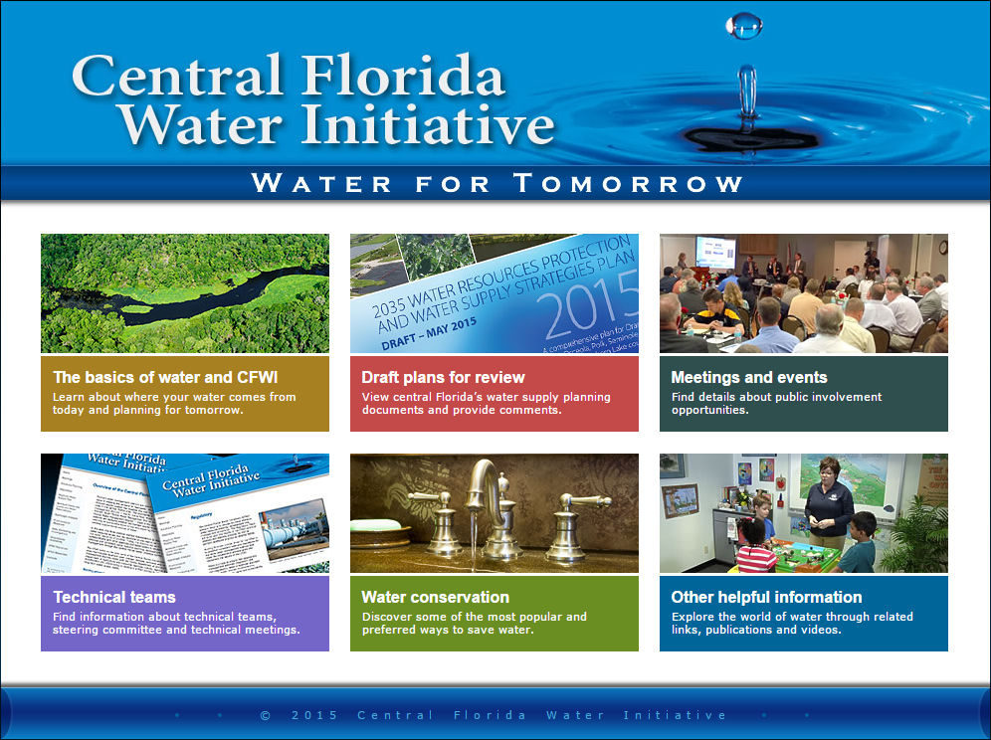
Thank you!
For more information visit
cfwiwater.com

