Slide 1

CENTRAL FLORIDA WATER INITIATIVE-
A REGIONAL RESPONSE TO AVOID A PENDING CRISIS
By: Michael D. Minton, Esq.
DEAN, MEAD, EGERTON, BLOODWORTH,
CAPOUANO & BOZARTH, P.A.
Orlando, Florida
February 6, 2014

Slide 2
I. Background
Central Florida is projected to almost double in population over the next 40 years with an increase of almost 3,000,000 new inhabitants bringing the total population to 6.6 million. Recognizing that:
(i) the potable water supply utilized by the Central Florida Region relies almost exclusively upon groundwater withdrawals from the upper and lower Floridan aquifer; and
(ii) the early warning signs that this is a diminishing supply which is incapable of re-charging rapidly enough to provide a sustainable water source.

Slide 3
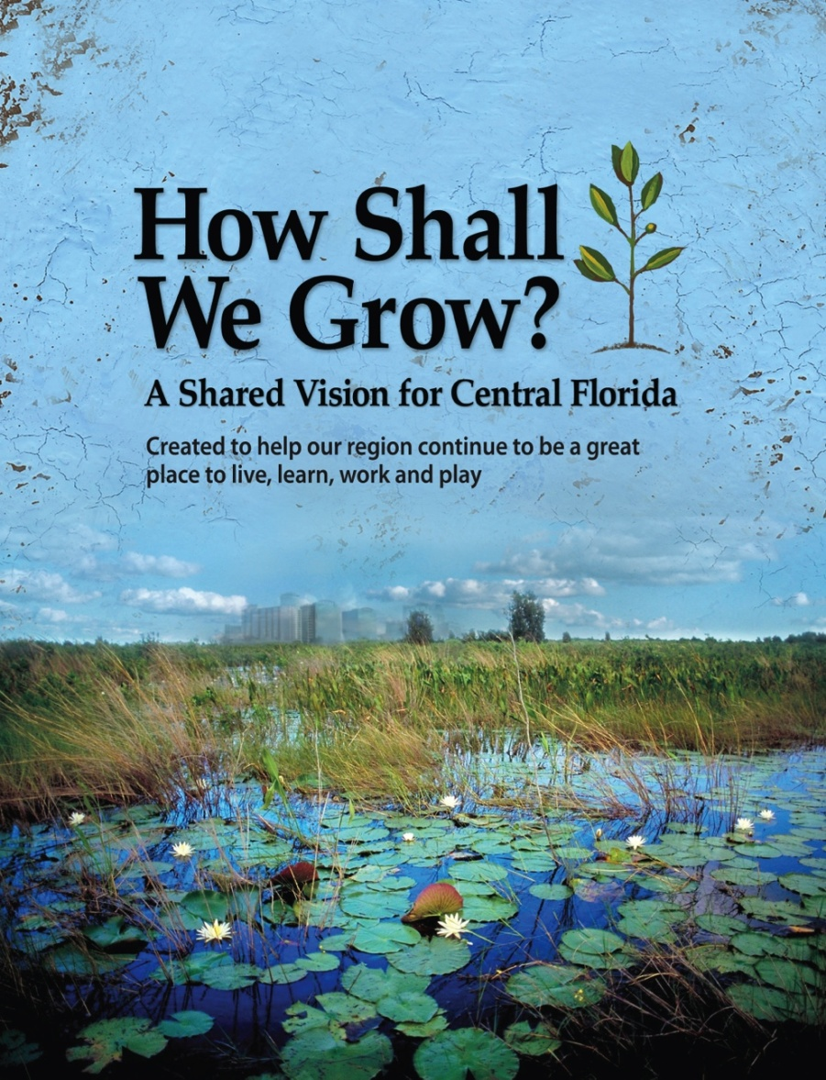
CENTRAL FLORIDA PARTNERSHIP
This process began with a community dialogue undertaken in 2006-2007 by myregion.org (one of the lines of business of the Central Florida Partnership) entitled “How Shall We Grow” which was designed to develop a shared regional vision for Central Florida.
Business abhors uncertainty as to necessary resources and infrastructure!

Slide 4
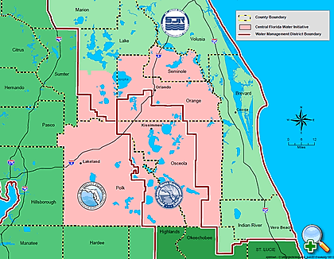
The Big Pizza!

Slide 5
WATER MANAGEMENT DISTRICTS
Three water management districts govern water use in the region – St. Johns River Water Management District, Southwest Florida Water Management District and South Florida Water Management District:
I. Central Florida Coordination Area (“CFCA”) which includes:
A. Seminole, Orange, and Osceola counties and South Lake County from within the St. Johns River Water Management District;
B. Orange, Osceola and Polk counties from within the South Florida Water Management District; and
C. Polk County from within the Southwest Florida Water Management District.
II. No consensus on modeling or agreed upon science for estimating the groundwater available had ever been achieved among the water management districts.
III. Through CFCA, the Districts issued a joint statement in 2008, that sustainable quantities of groundwater were insufficient to meet additional water demands beyond 2013 and that aggressive conservation, use of reclaimed water, and development of alternative water supplies were essential.

Slide 6
CONGRESS OF REGIONAL LEADERS
The Congress of Regional Leaders, a regional organization consisting of sixteen (16) elected officials representing city and county govern-ments and the school boards of the seven (7) Central Florida counties (Brevard, Lake, Orange, Osceola, Polk, Seminole and Volusia) took up this issue and listed two over-arching goals it wanted this regional community effort to achieve:
1. Create a regional water strategy for Central Florida; and
2. Avoid the use of any public money to litigate over water.

Slide 7
In early 2009, the Congress of Regional Leaders engaged myregion.org and Urban Land Institute Central Florida (“ULI Central Florida”) to address these goals. Through a consensus-building process,
A. A white paper was issued in December 2010 entitled “Creating a Sustainable Water Supply for Central Florida; A Regional Strategy – Recommendations.” The conclusions reached during this process were as follows:
1. Water is undervalued;
2. Water users will not be able to use groundwater from the Floridan aquifer to supply all future needs without causing unacceptable environmental impacts;
3. Conservation must be a central part of any regional water use strategy;
4. Alternative water sources are available, but at much higher costs. Tapping them economically will require a substantial investment and a coordinated regional effort.

Slide 8
B. Phase One of this regional community effort in 2010 identified the challenges ahead:
1. How to reduce consumption while building infrastructure requirements for sustainable future supply; and
2. How to accomplish this without placing undue financial burden on utilities.

Slide 9
C. The second phase took place in the Summer of 2011, during which myregion.org and ULI Central Florida convened a Technical Assistance Panel of public and private sector, local, state and national subject matter experts to undertake the task of:
“Explore how the region can rise above political boundaries and find a way to approach future water use as a cohesive team. What kinds of political infrastructure will have to be put in place to make this happen? Who would oversee the effort? How would every county, municipality, water distributor and other stakeholders be brought into the project and have a voice?”
The challenge we face is how to facilitate the formation of the multi-jurisdictional entities needed to ensure the future planning, construction and operation of alternative water supply programs and projects to meet future water supply needs.
D. Technical Assistance Panel that developed the report entitled “Creating a Regional Water Civic Architecture for Central Florida”.

Slide 10
Today, the CFCA effort has transitioned into the Central Florida Water Initiative (“CFWI”), a collaboration involving the three water management districts, the Florida Department of Environmental Protection (“DEP”), the Florida Department of Agriculture & Consumer Services (“DACS”), and the major public water suppliers in Central Florida.
Guiding principles
The guiding principles of the CFWI:
A. Identify the sustainable quantities of traditional groundwater sources available for water supplies that can be used without causing unacceptable harm to the water resources and associated natural systems.
B. Develop strategies to meet water demands that are in excess of the sustainable yield of existing traditional groundwater sources.
C. Establish consistent rules and regulations for the three water management districts that meet their collective goals, and implement the results of the Central Florida Water Initiative.

Slide 11
Steering Committee
The Steering Committee oversees the CFWI process and provides guidance to the technical teams and technical oversight/management committees that are developing and refining information on all aspects of Central Florida’s water resources. The Steering Committee includes the following:
Public water supply utility representative;
Governing Board member from each of the three water management districts;
Representative from DEP; and
D. Representative from DACS.

Slide 12
Groundwater Availability Team (“GAT”)
The findings of this first technical Team are central to the content of the mission of CFWI. To my knowledge, this is the first time all three (3) WMD’s have agreed on the method to model and estimate the available groundwater for this region for planning purposes.
A. Estimated available groundwater from traditional sources (upper & lower aquifer) for utilization as water supply without requiring mitigation or other operational controls is 850 MGD (million gallons per day);
B. Current use from these traditional sources is about 800 MGD;
C. Current permitted use is about 1 BGD (billion gallons per day);
D. Estimated demand by 2035 is 1.1 BGD.
The Solutions Team was directed by the Steering Committee to assume for our planning purposes that there is a deficit need to be filled of 250 MGD ( 1.1 BGD- 850 MGD ).

Slide 13
Regional Water Supply Plan.
One of the other truly ground breaking efforts currently underway, the results of which will affect the Solutions Team findings, is the development of a regional water supply plan applicable throughout the region and which is consistent with the three WMD water supply plans that divide the region. Comment Period extended to Feb. 20, 2014.
[Website: http://cfwiwater.com].

Slide 14
Minimum Flows and Levels (“MFL’s”)
Another technical team providing important information is analyzing the impact of withdrawals upon Minimum Flows and Levels (“MFL”) for water bodies, wetlands and other natural resources to develop a coordinated strategy for the region. The work of this team is extremely important in focusing the recommendations coming from the Solutions Team upon those options that will not cause unacceptable impacts upon the environment, identifying what mitigation or management steps need to be taken to minimize the impact of withdrawals where additional groundwater withdrawals are necessary to meet the increased demand. Will also play an important role in the development of future regulations for the region.
What is a MFL?
Water management districts use a variety of information to scientifically establish the point beyond which additional withdrawals would cause significant harm. Usually the districts select a peer review committee to evaluate the scientific principles and methods used to establish an MFL. Once an MFL is calculated and is adopted by rule, implementation is undertaken by the districts. For more information please see the website for CFWI [http://cfwiwater.com] and view the page for Minimum Flows and Levels and Water Reservations.

Slide 15
Solutions Team. The Chair of our Team is Robert Beltran, the Executive Director of SWFWMD
A. Scope of Work (“SOW”) - approved Oct. 25, 2013.
B. The SOW generally provides that our Solutions Team will focus on identifying projects that are large scale, multi-jurisdictional and of regional significance to serve more than one utility. Sub-Teams have been formed to analyze different “ buckets” of available water. We also plan to identify potential regional interconnect opportunities between the Districts and basins. Our work will culminate with our Report due next winter - The 2035 Water Resources Protection and Water Supply Strategies Plan.
C. The following is the list of Sub-Teams:
1. Surface Water (Dispersed storage and Reservoirs)
2. Groundwater
3. Reclaimed Water
4. Conservation and Other Management Strategies (Agriculture and Urban Landscape)
5. Recovery/Prevention Projects (Coordinated with other teams as needed)
6. Other (Stormwater, etc…)
An overriding premise is that the inexpensive water sources are already being utilized and these alternative sources will cost more, and in most cases, significantly more.

Slide 16
Conclusion
As you might expect, the CFWI is a very dynamic process with really challenging issues to address. The public should avail itself of every available opportunity to become better educated and participate in this very important initiative.
Quote from Tom Peters:
“If you’re not confused, then
you’re not paying attention!”

Slide 17
CENTRAL FLORIDA WATER INITIATIVE-
A REGIONAL RESPONSE TO AVOID A PENDING CRISIS
By: Michael D. Minton, Esq.
DEAN, MEAD, EGERTON, BLOODWORTH,
CAPOUANO & BOZARTH, P.A.
Orlando, Florida
February 6, 2014

